Slide 1
IMAGE THRESHOLDING
Thresholding is a type of image segmentation, where we change the pixels of an image to make the image easier to analyze.
In thresholding, we convert an image from color or grayscale into a binary image, i.e., one that is simply black and white.

Slide 2
IMAGE THRESHOLDING
Thresholding produces a binary image, where all pixels with intensities above (or below) a threshold value are turned on, while all other pixels are turned off.
The binary images produced by thresholding are held in two-dimensional NumPy arrays, since they have only one color value channel. They are boolean, hence they contain the values 0 (off) and 1 (on).
Thresholding can be used to create masks that select only the interesting parts of an image, or as the first step before Edge Detection or finding Contours.

Slide 3
IMAGE THRESHOLDING USING OPENCV
Simple Thresholding (cv.threshold)
Adaptive Thresholding (cv.adaptiveThreshold)
Otsu Binarization (cv.threshold with cv.THRESH_OTSU as parameter)

Slide 4
SIMPLE THRESHOLDING
For every pixel, the same threshold value is applied.
If the pixel value is smaller than the threshold, it is set to 0, otherwise it is set to a maximum value.
The function cv.threshold is used to apply the thresholding.
The first argument is the source image, which should be a grayscale image.
The second argument is the threshold value which is used to classify the pixel values.
The third argument is the maximum value which is assigned to pixel values exceeding the threshold.
OpenCV provides different types of thresholding which is given by the fourth parameter of the function.

Slide 5
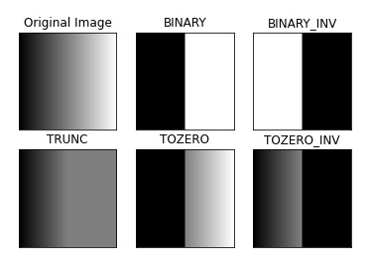
SIMPLE THRESHOLDING
cv.THRESH_BINARY
cv.THRESH_BINARY_INV
cv.THRESH_TRUNC
cv.THRESH_TOZERO
cv.THRESH_TOZERO_INV

Slide 6
ADAPTIVE THRESHOLDING
Using one global value as a threshold might not be good in all cases, e.g. if an image has different lighting conditions in different areas. In that case, adaptive thresholding can help.
Here, the algorithm determines the threshold for a pixel based on a small region around it.
So we get different thresholds for different regions of the same image which gives better results for images with varying illumination.

Slide 7
ADAPTIVE THRESHOLDING
The adaptiveMethod decides how the threshold value is calculated:
cv.ADAPTIVE_THRESH_MEAN_C: The threshold value is the mean of the neighbourhood area minus the constant C.
cv.ADAPTIVE_THRESH_GAUSSIAN_C: The threshold value is a gaussian-weighted sum of the neighbourhood values minus the constant C.
The blockSize determines the size of the neighbourhood area and C is a constant that is subtracted from the mean or weighted sum of the neighbourhood pixels.

Slide 8
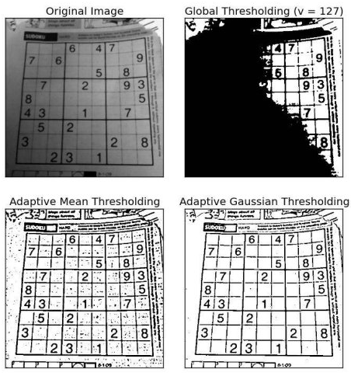
ADAPTIVE THRESHOLDING

Slide 9
OTSU BINARIZATION
In global thresholding, we used an arbitrary chosen value as a threshold. In contrast, Otsu's method avoids having to choose a value and determines it automatically.
Consider an image with only two distinct image values (bimodal image), where the histogram would only consist of two peaks. A good threshold would be in the middle of those two values. Similarly, Otsu's method determines an optimal global threshold value from the image histogram.
In order to do so, the cv.threshold() function is used, where cv.THRESH_OTSU is passed as an extra flag. The threshold value can be chosen arbitrary. The algorithm then finds the optimal threshold value which is returned as the first output.

Slide 10
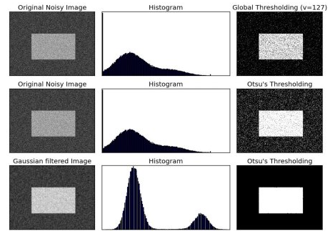
OTSU BINARIZATION

